Slide 1
Finding Micro-Cap Inefficiency
Analysis by Brian Bentson

Slide 2
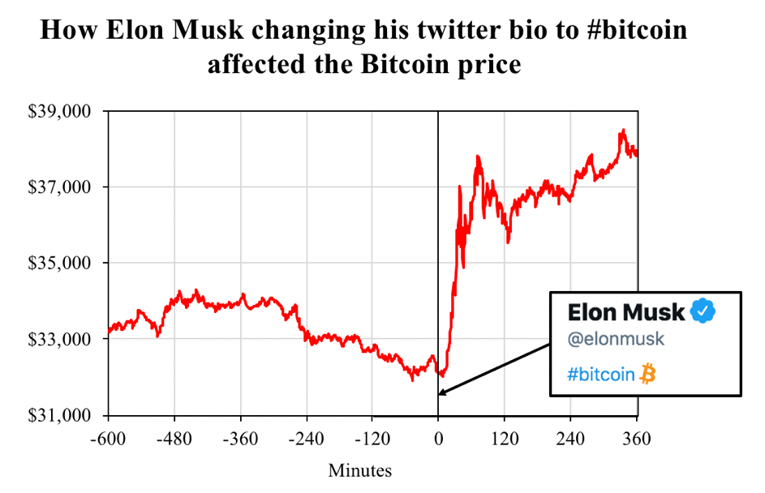
Capitalizing on Market Inefficiencies by finding undervalued micro-cap stocks with growth potential
Market inefficiencies exist when a stocks price does not accurately reflect the stocks true value
Finding stocks which are currently undervalued where their true value is much higher than their price suggests
Micro-cap companies have high inefficiencies due to low visibility especially in large investment institutions (Small Firm Effect)
Source: https://www.blockchainresearchlab.org/2021/02/08/the-musk-effect-how-elon-musks-tweets-affect-the-cryptocurrency-market/

Slide 3
Selection Criteria for selecting stocks to buy
Value Metric: based on 5 key metrics which quantify a stocks cost in relation to their performance
Growth Potential Metric: based on a 1-year forecast of a company's revenue per share
BUY stocks which are cheaply priced and show growth potential into the future
HOLD stocks which are cheaply priced without growth or expensive with growth
SELL stocks which are expensive without growth potential
Value, No Growth
HOLD
Value + Growth
BUY
VALUE
Expensive, No Growth
SELL
Expensive, Growth
HOLD
GROWTH POTENTIAL

Slide 4
Data Overview
FMP
Sourced data from FMP’s API
114 Micro-cap stocks with no null or negative values
Pulled general stock info (stock ticker, company name, industry, country etc.)
Pulled 5 key value performance metrics for 2020
Pulled all historical data for revenue per share
Removed highly volatile sectors (Financial, BioTech, Project Management/Construction)
Financial Modeling Prep

Slide 5
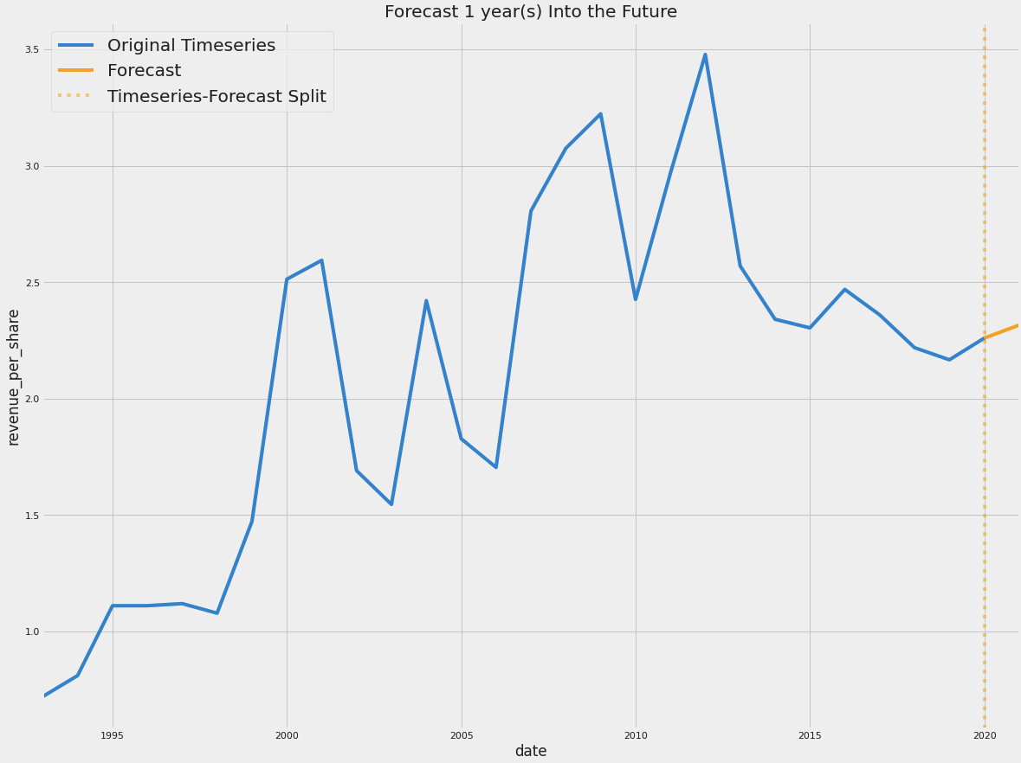
Analysis: Finding Market Inefficiencies using key performance metrics
Ranked stocks based on 5 “Value” performance metrics in 2020:
Value Performance Metrics
Price to Expense Ratio
Enterprise Value to Operating Cashflow
Enterprise Value Over EBITDA
Enterprise Value to Free Cashflow
Price to Sales Ratio
Forecasted Top 10 “Value” stocks on revenue per share, 1 year into the future
Evaluated growth potential based on predicted 1 year percent growth of revenue per share
2.48% Forecasted Increase in Revenue per Share

Slide 6
Analysis Results
Symbol ID | 2020 Value Ranking | 1 Year Growth Rate | Revenue per Share | Final Action
19264 | 1 | 4.34% | $15.7 | BUY
10161 | 2 | 8.37% | $81.58 | BUY
14746 | 8 | 10.25% | $58.22 | BUY
13554 | 9 | 4.39% | $72.17 | BUY
18302 | 10 | 3.45% | $7.26 | BUY
6760 | 3 | -5.35% | $3.58 | HOLD
17272 | 4 | -10.71% | $10.92 | HOLD
7134 | 5 | -52.25% | $6.01 | HOLD
343 | 6 | -1.31% | $0.37 | HOLD
9074 | 7 | -5.32% | $0.24 | HOLD
Final action accounts for combination of value and potential future growth
Utilized a mixture of auto-fit models and manual fit models due to high volatility in revenue per share, specifically in 2020
Half of the high value stocks offered positive growth and should be bought

Slide 7

Conclusion and Next Steps
The combination of high performing value metrics and growth potential is key to finding undervalued stocks
Model more stocks to get a full view of smart buys of undervalued stocks
Explore additional metrics that track company growth such as stock price
This Photo by Unknown Author is licensed under CC BY-NC-ND

Slide 8
Thank you
Questions?

Slide 9
Appendix

Slide 10
2.48% Forecasted Increase in Revenue per Share

